Slide 1

COMSIS: COMPUTERIZED SALES AND INVENTORY SYSTEM FOR CENTRO MERCADO

Slide 2






OUR TEAM
Boniza, Renan
Ching, Jerick Aeron
Janoras, Daisy
Naval, Jancen
Mallari, Lean Kurt

Slide 3
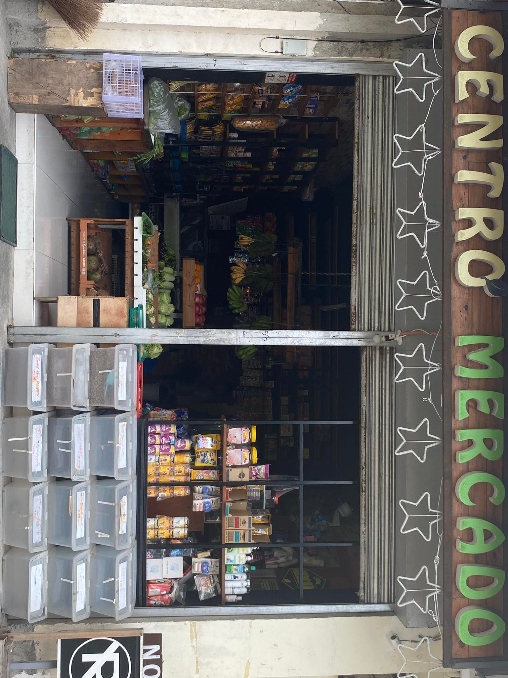
Client

Slide 4
Introduction
The Computerized Sales and Inventory System is designed to aid the Centro Mercado in the monitoring of sales and inventory records. It assists in providing information on the tracking of past and present records. Manual sales and inventory systems are not usually applicable in a convenience store like the Centro Mercado because they give the staff a difficult time computing and monitoring products that the store obtains and acquires, and it also delays the progress.

Slide 5
OBJECTIVES OF THE STUDY
GENERAL OBJECTIVE:
DEVELOP A “COMSIS: A COMPUTERIZED SALES AND INVENTORY SYSTEM FOR CENTRO MERCADO”

Slide 6
OBJECTIVES OF THE STUDY
SPECIFIC OBJECTIVES:
TO DEVELOP AND IMPLEMENT A GENERATED MODULE THAT WILL MONITOR THE SALES RECORDS.
TO DEVELOP AND IMPLEMENT A MODULE THAT WILL MONITOR THE INVENTORY OF ITEMS OR PRODUCTS.
TO DEVELOP AND IMPLEMENT A FILE MAINTENANCE MODULE THAT WILL HANDLE THE FILES, RECORDS, AND IMPORTANT DATA.

Slide 7
Scope & Limitation
SCOPE
LIMITATIONS
Users - Administrator/Owner - Staff
• THE SYSTEM IS EXCLUSIVELY TO THE OWNER AND
AUTHORIZED PERSONNEL ONLY.
Modules
- Login Module
- Home Module
- Transaction Module
- Inventory Module
- Sales Module
Account Module
Recycle bin Module
Stock-in Module
Stock-out Module
• THE SYSTEM DOES NOT INCLUDE PAYROLL OPERATION AS WELL AS RECEIPT.
• ONLINE ORDERING DOES NOT COVER BY THE SYSTEM.

Slide 8

RESEARCH METHODS
AGILE Methodology

Slide 9
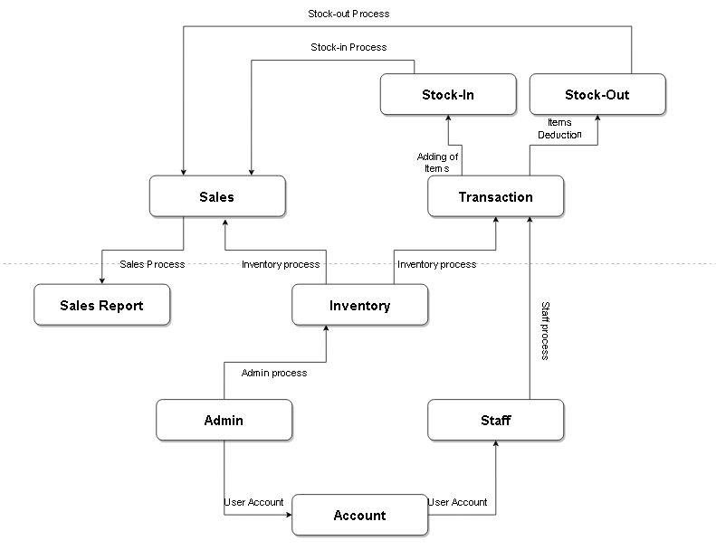
DATA FLOW DIAGRAM
Existing Context Diagram(Manual process)

Slide 10
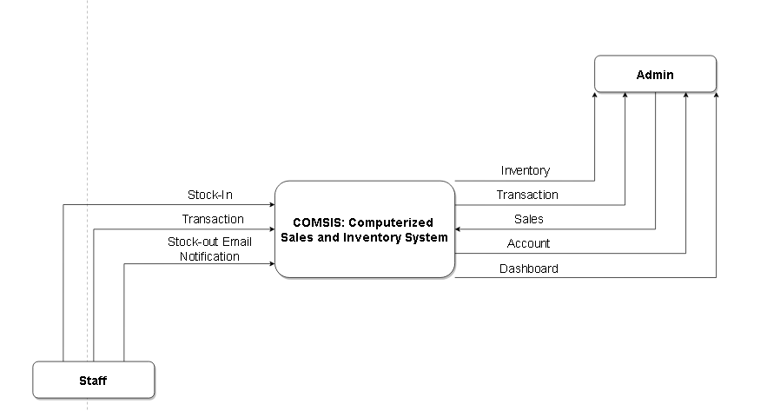
DATA FLOW DIAGRAM
Proposed Context Diagram(Automated or Computerized process)

Slide 11
System
Presentation

Slide 12
Thank You!

